Slide 1
ENG1002 English for Academic Purposes 1
Lecture 7
Module I EAP Characteristics
January 29/30, 2024

Slide 2
Instruction modules of ENG1002
Modules | EAP Characteristics | Research Steps
I | Formal and impersonal | Posing questions
II | Precise and clear | Citing sources
III | Honest and cautious | Avoiding logical fallacies

Slide 3
Formal & Impersonal Academic style and characteristics

Slide 4

Questions to think about
What are the purposes of academic writing?
What are the most common types of academic writing?
What are the general characteristics of academic writing?

Slide 5
1. Purposes of academic writing (Bailey, 2014)
to answer
to discuss
to synthesize
to report on
a question the writer has been given or chosen
a subject of common interest and give the writer’s view
research done by others on a topic
a piece of research the writer has conducted
(Bailey, 2014, p. 3)

Slide 6
2. The most common types of academic writing (Task 1)
Notes | a. A piece of research, either individual or group work, with the topic chosen by the student(s).
Report | b. The longest piece of writing normally done by a student (20,000+ words), often for a higher degree, on a topic chosen by the student.
Project | c. A written record of the main points of a text or lecture, for a student’s personal use.
Essay | d. A general term for any academic essay, report, presentation or article.
Dissertation/ Thesis | e. A description of something a student has done.
Paper | f. The most common type of written work, with the topic given by the teacher, normally 1,000–5,000 words
(Bailey, 2014, p. 3)

Slide 7
3. General characteristics of academic writing
 | Academic | Non-academic
Reader | academics | family and friends
Content | facts, serious thought | everyday events, emotions
Style | complex sentences showing considerable variety in construction | mostly simple and short sentences, incomplete sentences
Organisation | clear and well planned | loosely structured
Tone | formal, impersonal, objective | informal, personal, subjective
Vocabulary | technical and academic language | everyday words, short forms, idioms and slang

Slide 8
3. General characteristics of academic writing
 | Academic | Non-academic
Reader | academics | family and friends
Content | facts, serious thought | everyday events, emotions
Style | complex sentences showing considerable variety in construction | mostly simple and short sentences, incomplete sentences
Organisation | clear and well planned | loosely structured
Tone | formal, impersonal, objective | informal, personal, subjective
Vocabulary | technical and academic language | everyday words, short forms, idioms and slang

Slide 9
3. General characteristics of academic writing
has focused and specific expectations
emphasizes logical reasoning over emotional or sensory perceptions
attempts to be accurate, impersonal, and objective
must be coherent

Slide 10
Basic assumptions
The ideas of “formal/informal” and “personal/impersonal” are relative, rather than absolute.
Academic language is relatively formal and impersonal, but there is still much overlap between academic and “non-academic” language use.
Think of features of formality as forming a continuum.
informal
formal
Oral-like
Written-like

Slide 11
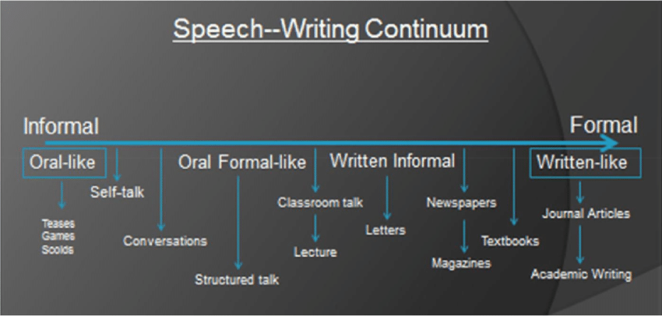
Notes:
Source: this figure was extracted from the following study
Horowitz, Rosalind & Wilburn, Marcy. (2017). Creating a Macrostructure in Academic Writing: Contributions of Tutor–Tutee Interaction When Performing a Text Revision. Reading & Writing Quarterly. 33. 364-379. 10.1080/10573569.2016.1255578.

Slide 12
Task 2. Work with your partner for five minutes and categorize the following items into Dos and Don’ts in academic writing
Vague language (about a hundred)
Academic vocabulary
Absolute statements
Repetition
Basic language/words (like, lots of, get, good)
Tentative language (Possibly / seems / appears)
Etc. or and so on
Precise facts/figures: A few years ago - in 2014
Idiomatic/colloquial expressions (gonna/stuff)
Phrasal verbs (get rid of/look up)
Personal pronouns: I, you, we, in my opinion
Contractions (don’t, can’t, it’s)
Complex grammar structure (relatively)
Questions
Personal adverbs (luckily, fortunately, surprisingly)
Passive structures
Nominalisation/noun structures (An analysis of the data showed)
Referencing systems (APA /Harvard / Chicago…)

Slide 13
Task 2. Work with your partner for five minutes and categorize the following items into Dos and Don’ts in academic writing
Don’ts | Dos
Vague language (about a hundred) | 2. Academic vocabulary

Slide 14
Don’ts
Idiomatic/colloquial expressions: Kids/boss/gonna/stuff
Phrasal verbs: get rid of/look up (limit use)
Personal pronouns: I, you, we, in my opinion
Contractions: don’t, can’t, it’s
Questions: What were the reasons for this phenomenon?
Personal adverbs: luckily, fortunately, surprisingly
(Bailey, 2014, p. 139-140)

Slide 15
Don’ts
Vague language: about a hundred-> approximately
Absolute statements: education reduces crime→may reduce crime or tends to reduce crime.
Repetition: constant repeating same words
Basic language: like-for example, lots of – significant amount, get – obtain, hard – difficult, good / bad – positive / negative
Etc. or and so on
(Bailey, 2014, p. 139-140)

Slide 16
Dos
Passive structures: We analyzed the data → The data was analyzed
Nominalisation/noun structures: An analysis of the data showed… (nominalized)
Tentative language: Possibly / seems / appears / could / may
Precise facts/figures: A few years ago - in 2014
Academic vocabulary (See Academic Word List)
Referencing systems (APA /Harvard / Chicago…)
Complex grammar structures
(Bailey, 2014, p. 139-140)

Slide 17
Task 3 Sentence Analysis
Please go through the sentences on worksheet and underline examples of poor style and rewrite them in a more suitable way
Another thing to think about is the chance of crime getting worse.
Regrettably these days lots of people don’t have jobs.
Sometime soon they will find a vaccine for malaria.
A few years ago, the price of property in Japan went down a lot.
Sadly, the high inflation led to poverty, social unrest and so on.
Bailey (2014, p.140-141) Unit 2.13

Slide 18
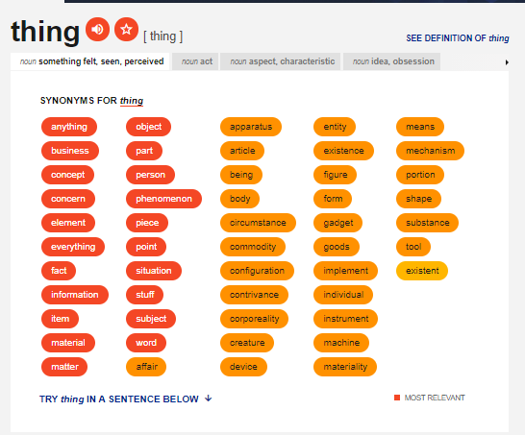
Example: (a) Another thing to think about is the chance of crime getting worse
Step 1. First highlight informal words / non-academic style:
(a) Another thing to think about is the chance of crime getting worse.
thesaurus.com
The example was adapted from https://www.academic-englishuk.com/academic-style

Slide 19
Example: (1) Another thing to think about is the chance of crime getting worse
Step 1. First highlight informal words / non-academic style
(a) Another thing to think about is the chance of crime getting worse.
Step 2. Use synonyms for informal words
Thing = fact / point / concern / factor
Think about = consider / analyze / understand / acknowledge
chance = possibility / probability / situation
getting = becoming/ turning/ growing
The example was adapted from https://www.academic-englishuk.com/academic-style

Slide 20
Example: (a) Another thing to think about is the chance of crime getting worse
Step 1. First highlight informal words / non-academic style
(a) Another thing to think about is the chance of crime getting worse.
Step 2. Use synonyms for informal words
Thing = fact / point / concern / factor
Think about = consider / analyze / understand / acknowledge
chance = possibility / probability / situation
getting = becoming/ turning/ growing
Step 3. Rewrite the sentence
Another point to consider is the possibility of crime becoming worse.

Slide 21
Example: (a) Another thing to think about is the chance of crime getting worse
Step 4. Grammar change: nominalization structure
Another point to consider is the possibility of crime becoming worse.
Another point of consideration is the possibility of crime becoming worse.

Slide 22
(a) Another thing to think about is the chance of crime getting worse
Another point to consider is the possibility of crime becoming worse
Another point of consideration is the possibility of crime becoming worse

Slide 23

Work on it for five minutes

Slide 24
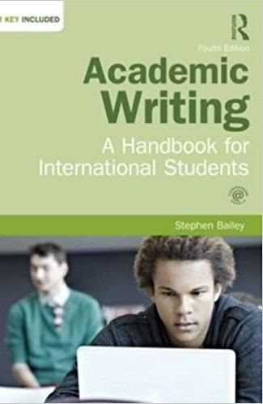
References
Bailey, S. (2014). Academic Writing: A Handbook for International Students (4th edition). Abingdon: Routledge.
Hamp-Lyons, L., & Heasley, B. (2006).Study Writing: A Course in Written English for Academic Purposes (2nd ed.). Cambridge University Press.
Horowitz, Rosalind & Wilburn, Marcy. (2017). Creating a Macrostructure in Academic Writing: Contributions of Tutor–Tutee Interaction When Performing a Text Revision. Reading & Writing Quarterly. 33. 364-379. 10.1080/10573569.2016.1255578.

Slide 25


